Slide 1
Image Captioning and Generating Text by GPT-2
Hashim Hashimov
Kayahan Kaya
Huseyn Garayev

Slide 2
Agenda
Introduction
Objective
Dataset
Adopted Approaches
Result
Conclusion
Future work
References

Slide 3
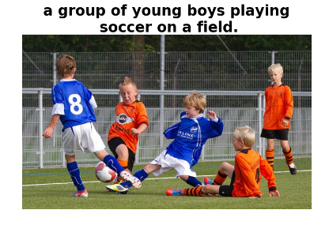

INTRODUCTION
Image Captioning
GPT-2

Slide 4
Objective
Creating description to the given image
Generating sentences based on obtained description.

Slide 5
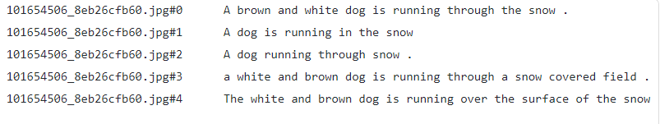
Dataset
We used Flickr8k dataset which contains 8000 images associated with 5 captions.
6000 train images
1000 validation images
1000 test images
Flickr30k
MS Coco

Slide 6
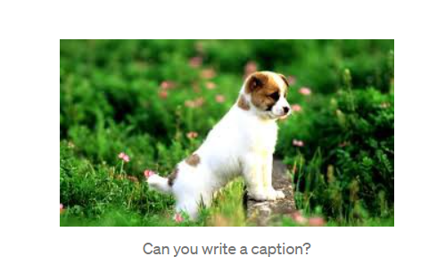
Image Captioning

Slide 7
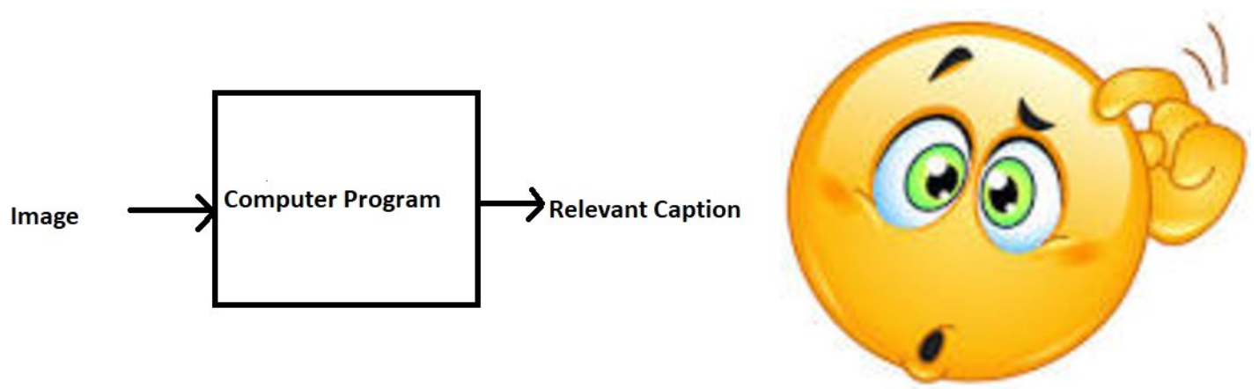
Image Captioning

Slide 8
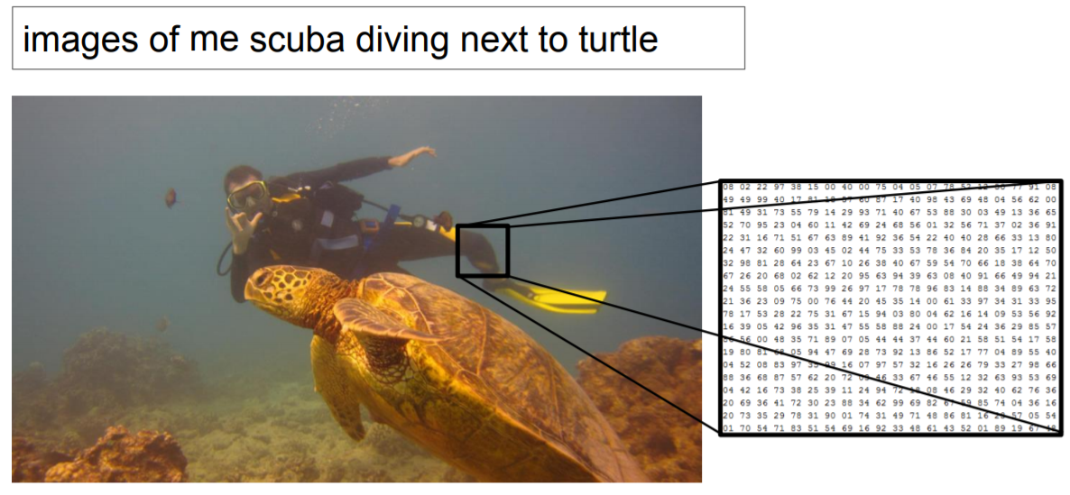
Image Captioning
It is very hard task for the computer!
https://cs.stanford.edu/people/karpathy/sfmltalk.pdf

Slide 9
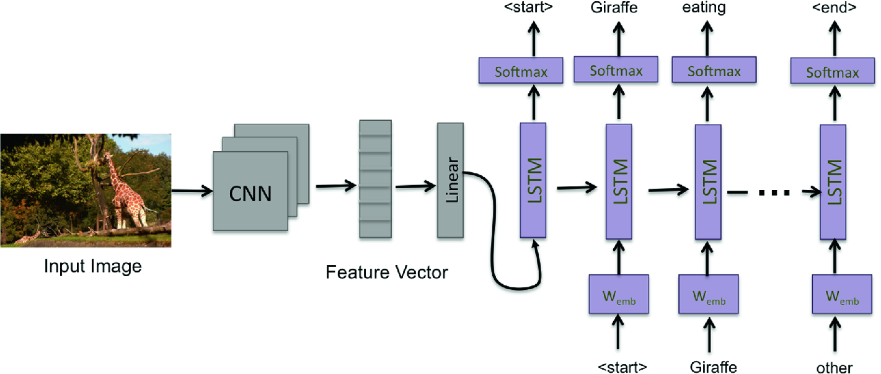
Encoder-Decoder Architecture

Slide 10
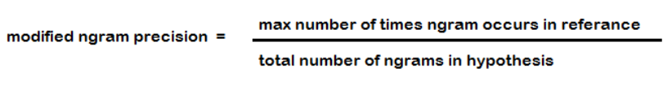
Evaluation Metric
We used Bleu Score to evaluate our model.
Bleu score ranges between 0-1.
Easy to calculate.
The comparison is made regardless of word order

Slide 11
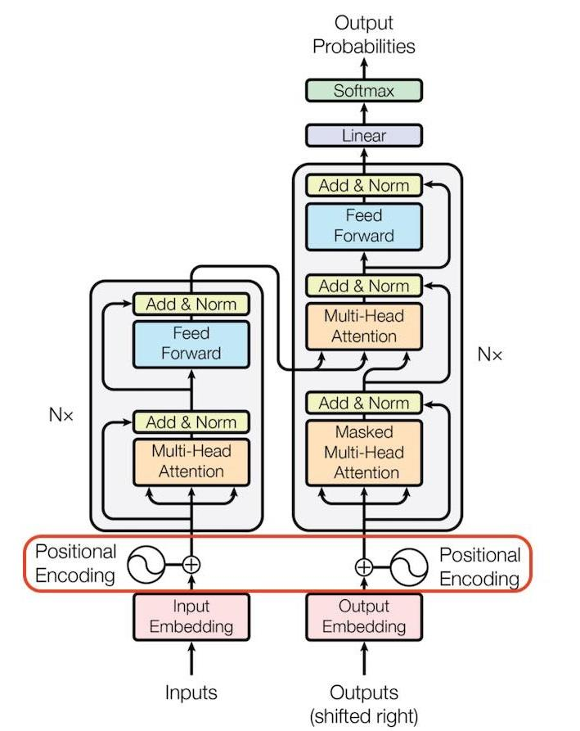
GPT-2
Transformer -based model
It is a big language model
The model that we used trained on 124 m words.
Created by Open AI

Slide 12
Dataset
We gathered 3 books together
“Miguel de Cervantes - Don Quixote”
“Mark Twain - Tom Sawyer
“Mark Twain - huckleberry finn”

Slide 13
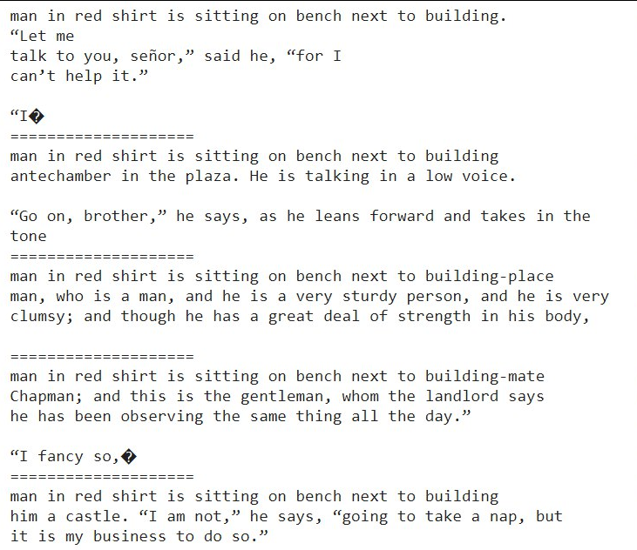
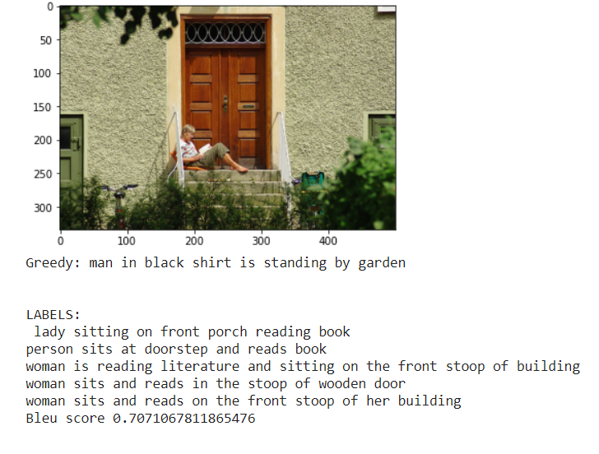
Result

Slide 14
Conclusion
Although image captioning is a challenging task, our model produces quite good results.
Bleu Score has some problem.
GP2 result is good but would be better.
Need much more GPU power computing for future work.

Slide 15
Future Work
Aim to apply attention mechanism to increase accuracy of the caption.
We are planning to use a bigger GPT model to generate more accurate continuation sentences.
Aim to help blind people.

Slide 16
References
Vision and Language: from Visual Perception to Content Creation - TAO MEI,WEI ZHANG,TING YAO
Automatic Image Captioning Based on ResNet50 and LSTM withSoft Attention - Yan Chu, Xiao Yue,Lei Yu,Mikhailov Sergei,and Zhengkui Wang
Image Captioning and Visual Question Answering Based on Attributes and External Knowledge - Qi Wu, Chunhua Shen, Anton van den Hengel, Peng Wang, Anthony Dick
Integration of textual cues for fine-grained image captioning using deep CNN and LSTM
https://github.com/jeffheaton/t81_558_deep_learning/blob/master/t81_558_class_10_4_captioning.ipynb
M. Hodosh, P. Young and J. Hockenmaier (2013) "Framing Image Description as a Ranking Task: Data, Models and Evaluation Metrics", Journal of Artificial Intelligence Research, Volume 47, pages 853-899 http://www.jair.org/papers/paper3994.html
https://towardsdatascience.com/image-captioning-with-keras-teaching-computers-to-describe-pictures-c88a46a311b8

Slide 17
THANK YOU...

